Slide 1
Lecture 6: Queue and Stack
Tsung-Wei (TW) Huang
Department of Electrical and Computer Engineering
University of Utah, Salt Lake City, UT

Slide 2
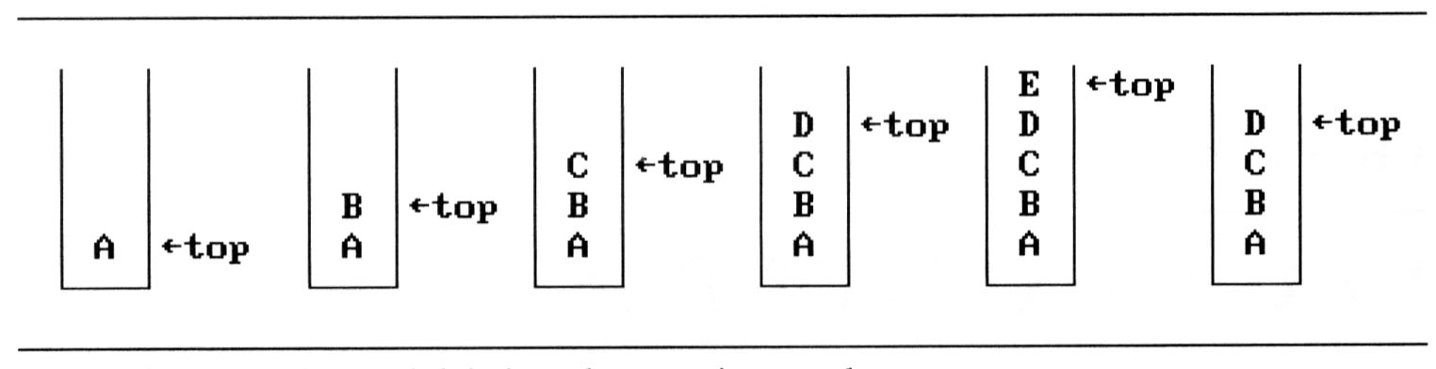
Stack
An ordered list supporting insertions and deletions
Push: push an element into the list
Pop: pop an element from the list in Last-In-First-Out (LIFO) order
If we add the elements A, B, C, D, E to the stack, in that order, then E is the first element we delete from the stack

Slide 3
Stack Visualization
Three main operations
Push: inserts a new item into the stack
Pop: removes the last inserted item from the stack
Top: query the top item in the stack
a₃
a₃
a₂
a₂
a₁
a₁
a₀
a₀
Push (Add)
Pop (Delete)

Slide 4
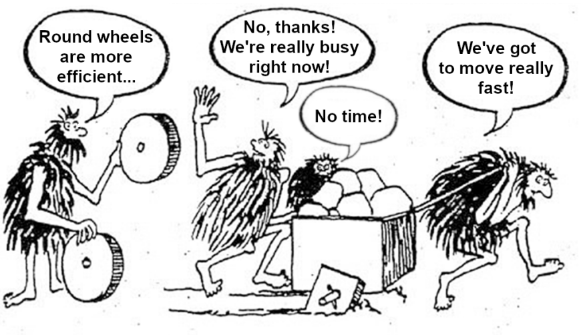
Stack Implementation in C++
Standard Template Library (STL)
https://en.cppreference.com/w/cpp/container/stack
/* stack example */
#include <iostream>
#include <stack>
int main()
{
std::stack<int> stk;
stk.push(1);
stk.push(2);
std::cout<<stk.top();
/* clear the stack */
while(!stk.empty())
stk.pop();
}

Slide 5
Stack in Recursive Programs
Stack frames of recursive function call
Always returns from the last recursion
fp
al
(activation record)
fp: a pointer to current stack frame
fp
main
stack frame of invoking function
system stack before a1 is invoked
system stack after a1 is invoked

Slide 6
Application: Parenthesis Checking
Input: a string of characters '(', ')', '{', '}', '[' and ’]’
Goal: determine if the input string is valid
An input string is valid if:
Open brackets must be closed by the same type of brackets.
Open brackets must be closed in the correct order.
Note that an empty string is also considered valid.
() | valid
()[]{} | valid
(] | invalid
([)] | invalid
{[]} | valid

Slide 7
Importance of Parenthesis Checking
A fundamental routine in language compiler
Need to parse a valid mathematical expressions
(3+2)*4*((9-6)/6)
(double)(1)/(2+7)
Need to parse a valid code block
int main () { return 0; }
void function() {}
auto lambda = [] () { my_work(); }
Many applications in physical design (e.g., floorplan)
Also, a very frequently asked question in interview
I was asked three times this question during job hunting

Slide 8
Property of a Valid Expression
A valid parenthesis string/expression must imply:
All subexpressions are valid

Slide 9
Recursive Validness
Remove the yellow pair

Slide 10
Recursive Validness
Remove the purple pair

Slide 11
Recursive Validness
Remove the green pair

Slide 12
Recursive Validness
Every subexpression is valid
Notes:
The stack data structure can come in handy here in representing this recursive structure of the problem. We can't really process this from the inside out because we don't have an idea about the overall structure. But, the stack can help us process this recursively i.e. from outside to inwards.

Slide 13
Algorithm
Initialize a stack S.
Process each bracket of the expression one at a time.
If we encounter an opening bracket, we simply push it onto the stack. This means we will process it later, let us simply move onto the sub-expression ahead.
If we encounter a closing bracket, then we check the element on top of the stack. If the element at the top of the stack is an opening bracket of the same type, then we pop it off the stack and continue processing. Else, this implies an invalid expression.
In the end, if we are left with a stack still having elements, then this implies an invalid expression.

Slide 14
Algorithm Walkthrough – 1
Notes:
We'll have a look a dry run for the algorithm and then move onto the implementation.

Slide 15
Algorithm Walkthrough – 2

Slide 16
Algorithm Walkthrough – 3

Slide 17
Algorithm Walkthrough – 4

Slide 18
Algorithm Walkthrough – 5

Slide 19
Algorithm Walkthrough – 6

Slide 20
Algorithm Walkthrough – 7

Slide 21
Algorithm Walkthrough – 8

Slide 22
Algorithm Walkthrough – 9

Slide 23
Algorithm Walkthrough – 10

Slide 24
Algorithm Walkthrough – 11

Slide 25
Algorithm Walkthrough – 11

Slide 26
Algorithm Complexity
Time complexity: O(n)
We traverse the given string one character at a time and push and pop operations on a stack take O(1) time.
Space complexity: O(n)
We push all opening brackets onto the stack and in the worst case, we will end up pushing all the brackets onto the stack. e.g. ((((((((((.

Slide 27
Queue
An ordered list supporting insertions and deletions
Push: insert a new item into the list
Pop: remove an item from the list in a First-In-First-Out (LIFO) order
If we add the elements A, B, C, D, E to the queue, in that order, then A is the first element we delete from the queue
a₀
a₁
a₂
a_{n-1}
front
rear

Slide 28
Queue Visualization
Three main operations
Push: inserts a new item into the queue
Pop: removes the earliest inserted item from the queue
front: query the front item in the queue
a₃
a₃
a₂
a₂
a₁
a₁
a₀
a₀
Push (Add)
Pop (Delete)

Slide 29
Queue Implementation in C++
Standard Template Library (STL)
https://en.cppreference.com/w/cpp/container/queue
#include <iostream>
#include <queue>
int main()
{
std::queue<int> que;
que.push(1);
que.push(2);
std::cout<<que.front();
/* clear the queue */
while(!que.empty())
que.pop();
}

Slide 30
Summary
We have discussed two fundamental data structures
Stack organizes data in last-in-first-out order
Queue organizes data in first-in-first-out order
We have discussed application of stack
Recursive program implementation
Parenthesis checking
Both data structures are widely used in physical design
For instance, slicing-tree Floorplan will leverage stack to recover the chip area from a linear representation string

